Slide 1
Presentation at Hisense Photonics
Yuchao Jiang, PhD
2018.12.10

Slide 2
Outline
Educational background
Past research experience
A detour in career
What I can do for HiSense Photonics

Slide 3
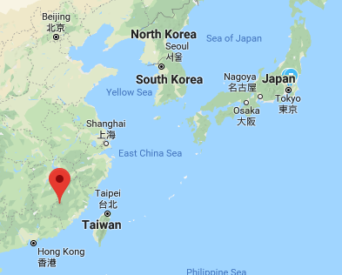
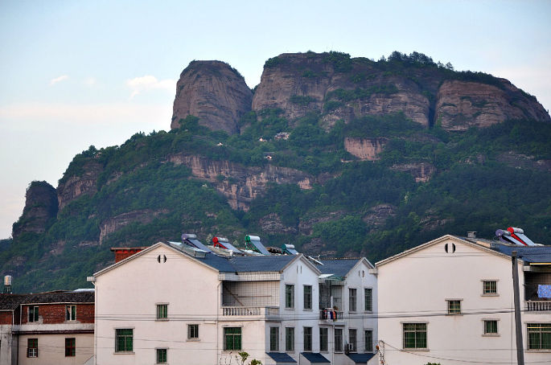



Educational Background
Born in FuJian(福建).
2007, B.S., Applied Physics.
2010. M.S., Material Physics.
2016. Ph.D. in Electrical & Computer Engineering.

Slide 4
My research experience
InP-based Quantum Cascade (QC) Lasers
Surface-emitting DFB QC lasers at λ ~ 4.6 µm
InAs-based Interband Cascade (IC) lasers
Single-mode DFB IC laser at λ=4.5 μm
CW operation above RT at λ=4.6-4.8 μm
Pulsed operation above RT at λ=6.2-6.7 μm
Electrically widely tunable IC laser near λ=7 μm
GaSb-based type-I IC lasers
CW operation above RT at λ=3.2 μm

Slide 5

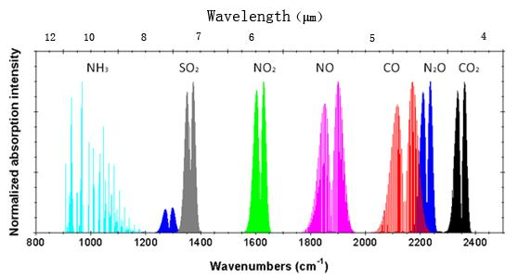
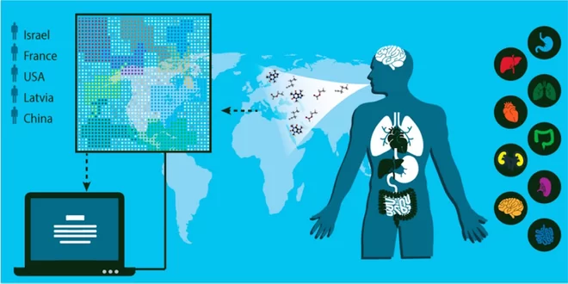
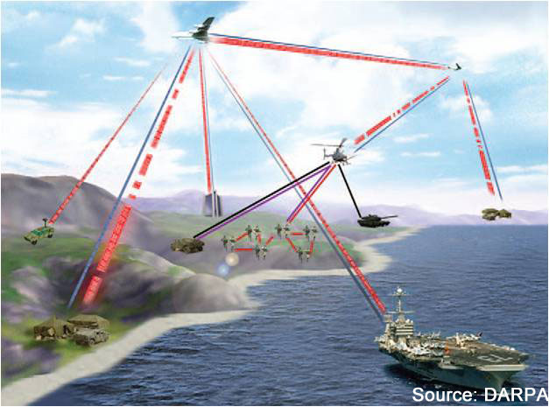
Why interband cascade (IC) lasers?
Mid-IR: 3-8 μm; Long-IR: 8~15 μm
Applications:
Gas-sensing
(ppb-level trace gas)
Free space optical communications
^{Launch: 2011.11.26}
^{Landing: 2012.8.6}
Highly energy efficient! 1/10 of competitor (QC laser).
Using iPhone 6 battery (10.5 Wh) can work ~50 hours.

Slide 6
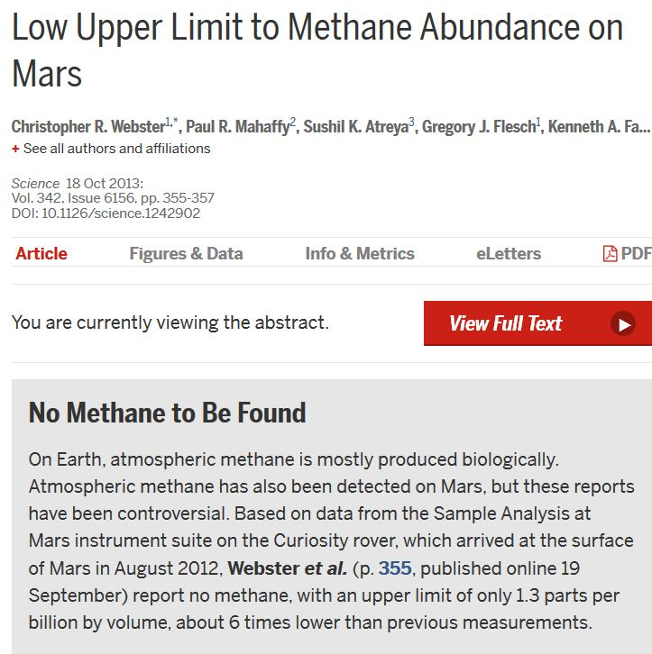
Methane on Mars? No?
One year after landing…
Notes:
Sensing methane is difficult

Slide 7
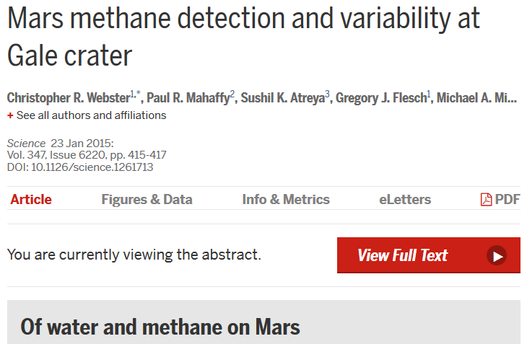
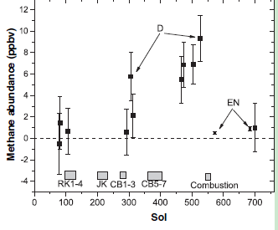
Methane on Mars? Yes!
Another year passes…
1 Mars year = 687 earth days
1 Mars day = 1 earth day + 41 min
Notes:
https://mars.nasa.gov/allaboutmars/facts/#?c=inspace&s=distance

Slide 8
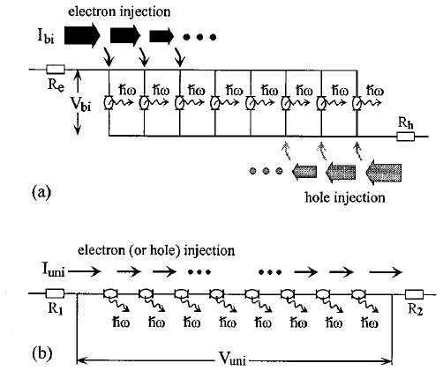
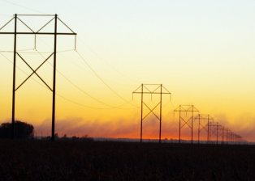
Why interband cascade (IC) lasers? vs. non-cascade interband lasers
Shared issues for any interband lasers:
free carrier absorption loss
Auger recombination dominates J_{th}(=e∙n_{th}/ τ)
Advantages of cascade structure :
reduce n_{th}-> reduce Auger
Analogy: power transmission line -> lower ohmic loss
R. Yang, S. Pei, J. Appl. Phys. 79,8197(1996)
 | type | equivalent circuit | key difference
a | MQW laser | in parallel | low voltage
b | IC laser | in series | low current
GaN LED in a cascade structure overcame efficiency droop.
F. Akyol, et al., Appl. Phys. Lett. 103,081107(2013)

Slide 9
Why interband cascade (IC) lasers? vs. quantum cascade (QC) lasers
Only two technologies capable of CW RT in mid-IR
 | QC laser | IC laser
material system | InGaAs/InAlAs/InP | InAs/GaSb/AlSb
carrier transition, lifetime | inter-subband, ~1 ps | interband, ~1 ns
threshold current density | 860 A/cm² @4.6μm | 100 A/cm² @3.6μm
threshold voltage | 12.8 V (40 stages) | 3 V (10 stages)
threshold power density | 11 kW/cm² | 0.3 kW/cm²
maximum output power | 5.1 W | 0.6 W
thermal conductivity | InP: 68 W/m∙K | GaSb:33; InAs:27
ref: APL, 95,141113 (2009) ; APL, 102,231123(2013)
APL, 89,181102 (2011); Opt Exp., 22,7702(2014)
IC laser is a better solution for battery powered applications.

Slide 10
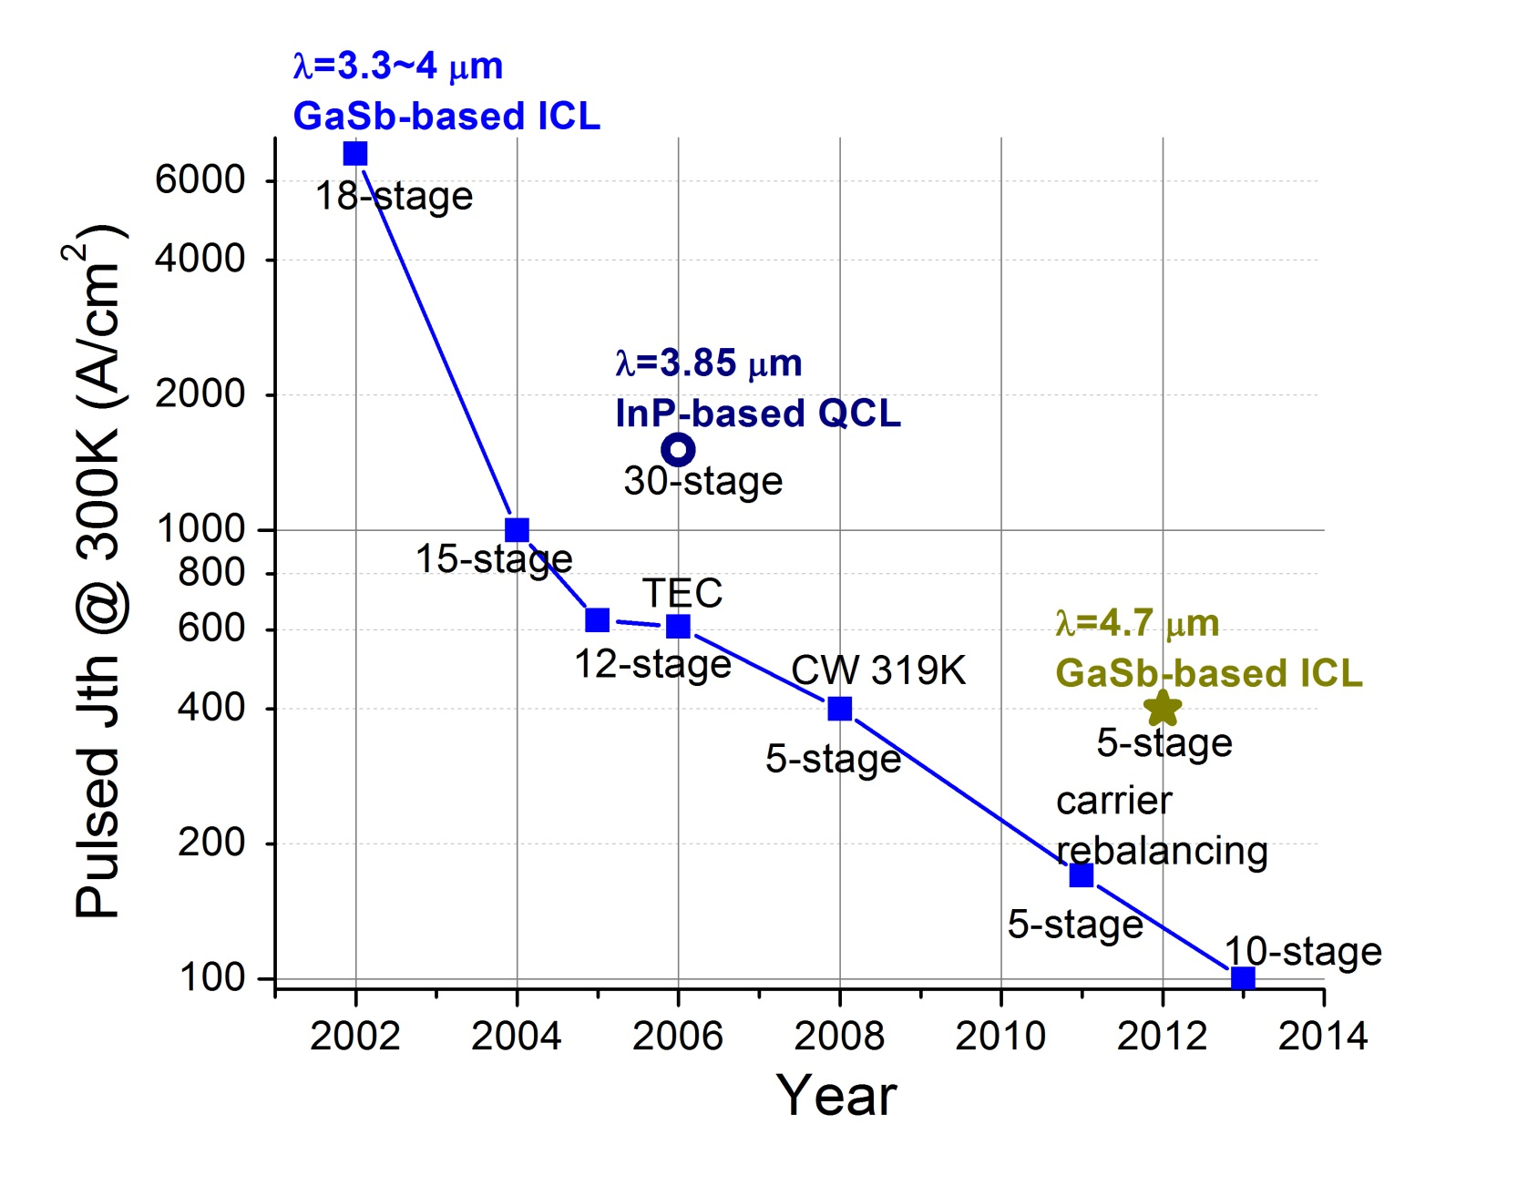
Snapshot of IC laser development
How the progress is made?
better material & fabrication
improved understanding & design
trial and error

Slide 11
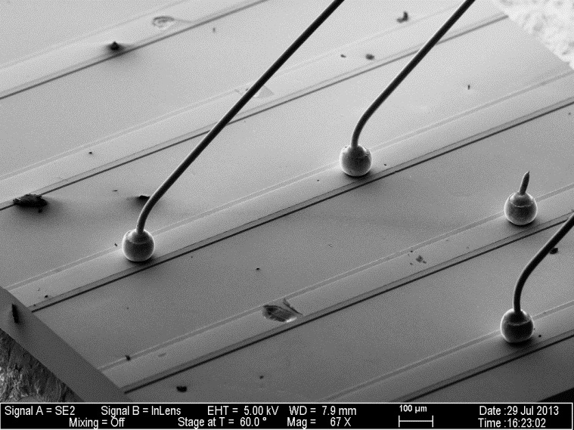
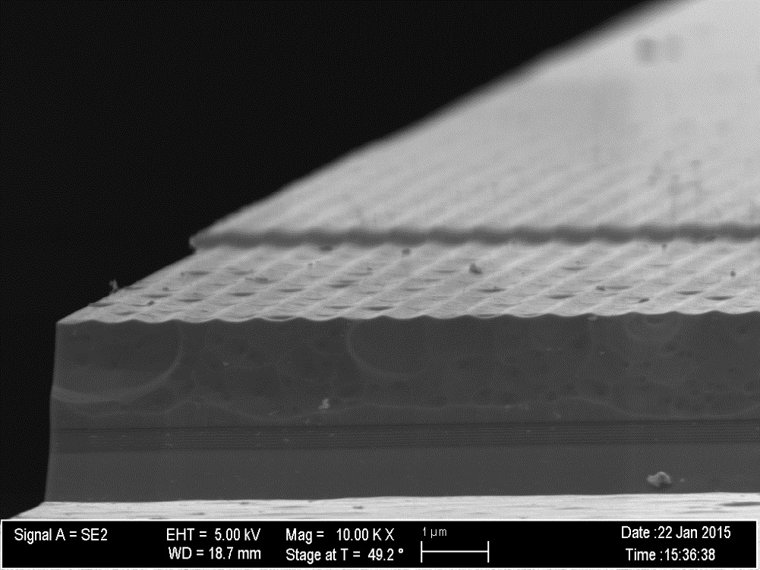
Real device & testing set-up
Laser
LN₂
Laser mesa
Trench
Current in
200 μm
Side
view
Temperature
Controller
Cryostat
Semiconductor grating
Vacuum
Top spacer
sensor A
Light
out
heater
Cascade stages
sensor B
Bottom spacer
1 μm

Slide 12
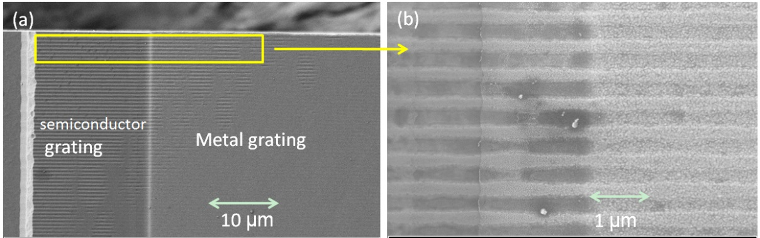
InAs-based Single-mode DFB IC laser
Single frequency-mode laser is desirable for gas-sensing
First DFB IC laser with an asymmetric waveguide
Y. Jiang, et al., IEEE J. Quantum Electron. 51, 2300307(2015)

Slide 13
Laser design for lowering Jth(T)
Modal gain (measurable)
Material gain (unmeasurable)
Confinement factor
of Active QWs
End goal: minimize threshold:
Design approaches:
Active core optimization
Optical waveguide optimization

Slide 14
Band structure of IC laser
bias
Design innovations since the prototype by R. Yang in 1994:
“W” like active region
2 QWs in hole injector
fine tune barrier thickness
semi-metallic interface
shortened electron injector
“carrier rebalancing”
(not fully understood)
“Rebalancing of internally generated carriers for mid-infrared interband cascade lasers with very low power consumption”,
Vurgaftman, et al., Nature Communication, 2, 585 (2011)

Slide 15
Waveguide structures of IC lasers
InAs/AlSb Superlattice Waveguide
InAs Plasmon-Enhanced Waveguide
Contact
Contact
InAs/AlSb SL
top cladding
InAs n⁺⁺
InAs Spacer
GaSb Spacer
Cascade Stages
n=3.45
Cascade Stages
n=3.45
GaSb Spacer
n=3.73
InAs Spacer
n=3.49
InAs/AlSb SL n=3.35
bottom
cladding
InAs n⁺⁺ n~3
GaSb Substrate
InAs Substrate
Material | Thermal Conductivity
InAs/AlSb SL | ~ 2.7 W/m·K
InAs | ~ 27 W/m·K
GaSb | ~ 33 W/m·K
Better thermal dissipation
Simplify the growth
Tunable refractive index
InAs-based IC lasers may be
a better solution at longer λ

Slide 16
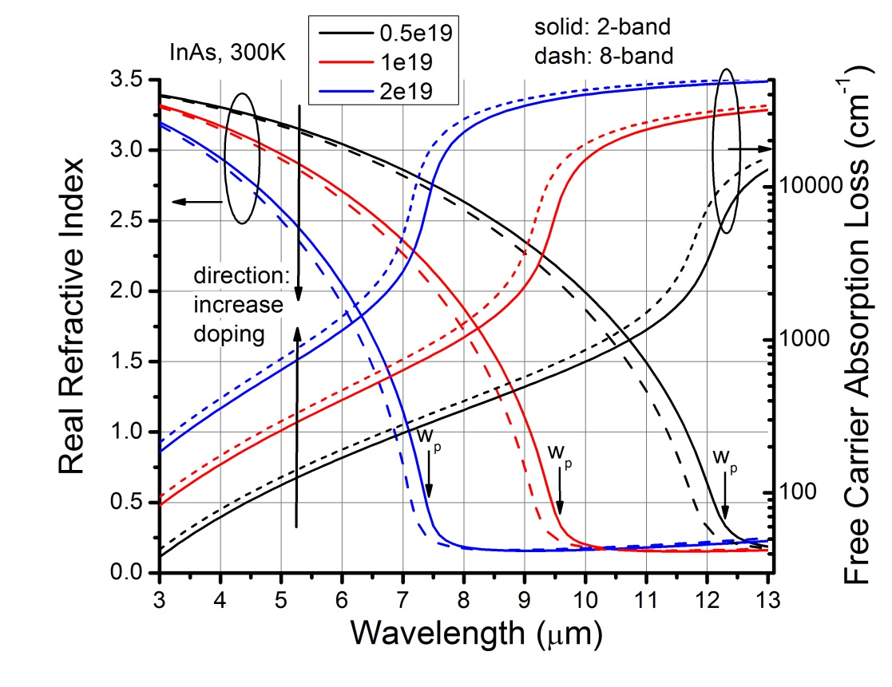
Optical waveguide optimization(1)
plasmon
frequency
doping
concentration
Drude model
When λ_{emission} near λ_{plasmon}:
n decreases sharply
loss increase exponentially

Slide 17
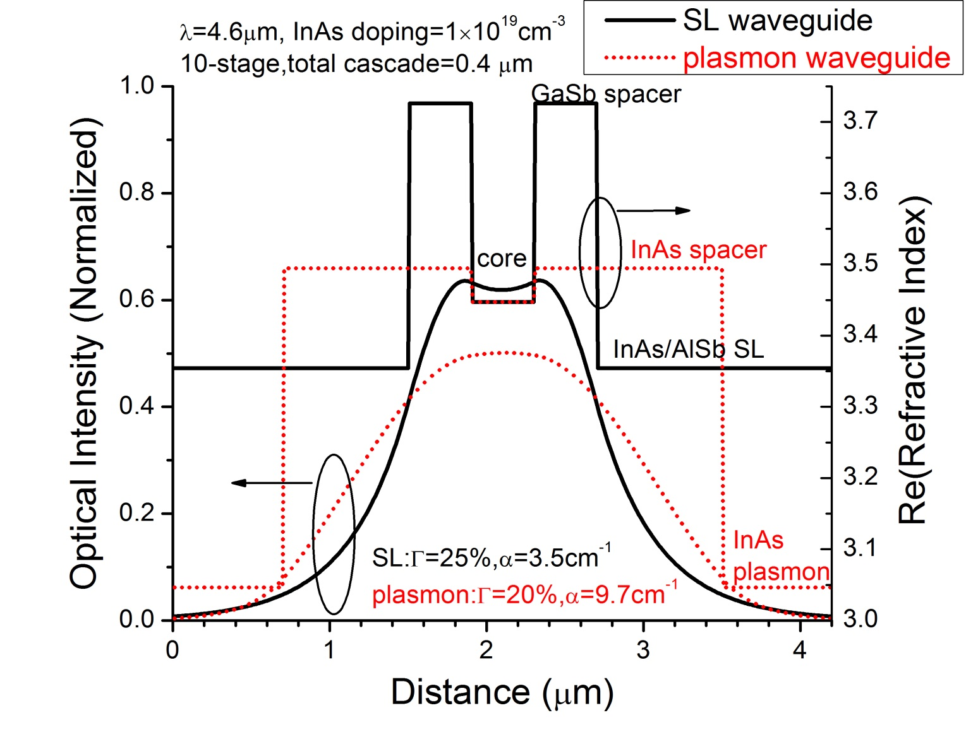
Optical waveguide optimization(2)
Plasmon waveguide
requires higher
material gain!

Slide 18
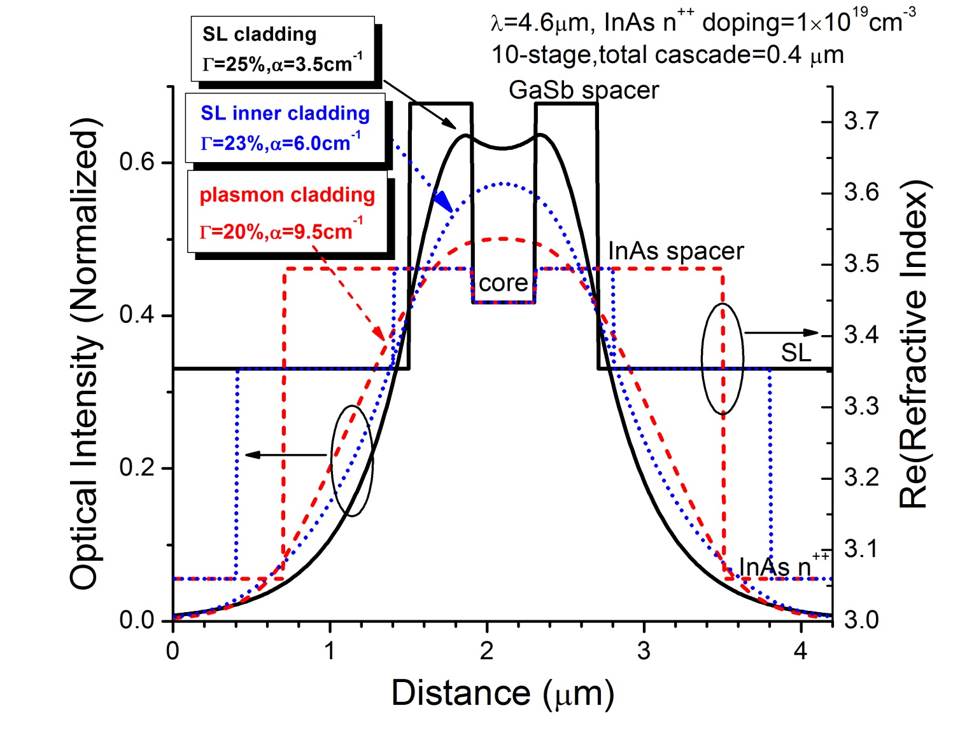
Optical waveguide optimization(3)
Hybrid waveguide:
InAs spacer layer
InAs/AlSb SL inner cladding
InAs plasmon outer cladding
Predict threshold gain
reduced by ~30%

Slide 19
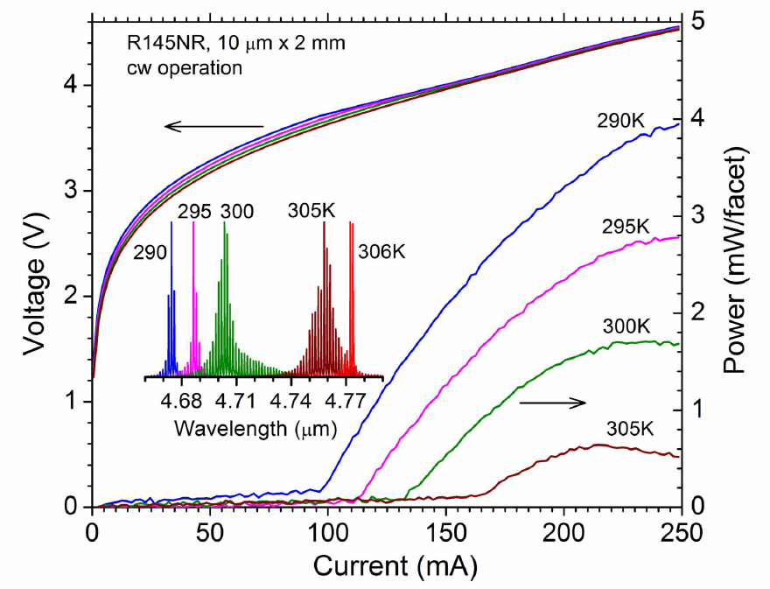
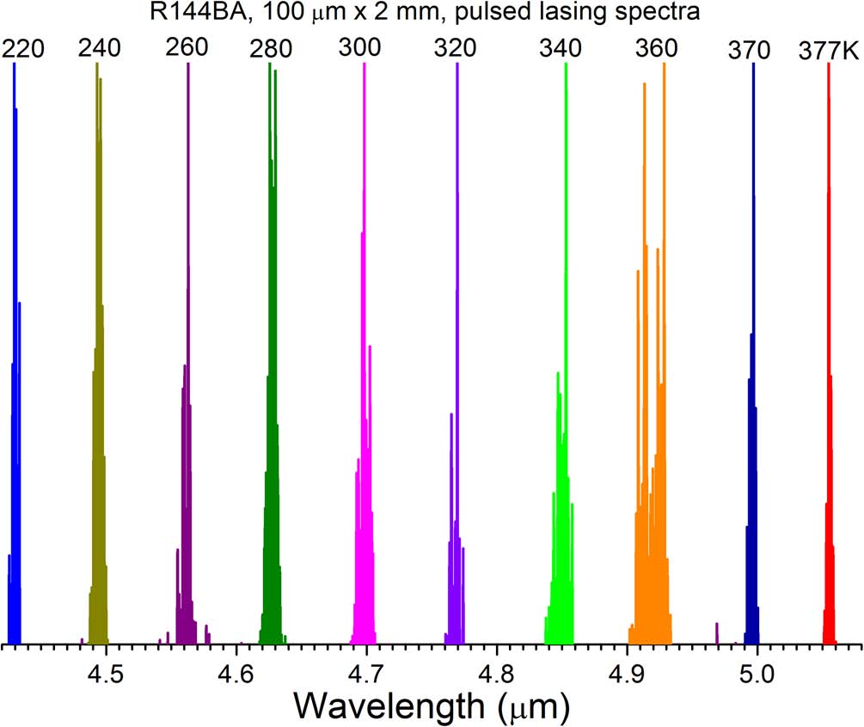
CW RT operation at λ=4.6-4.8 μm (1)
J_{th}: 670 A/cm² at 300 K
Voltage efficiency: ~70%
Input power: 0.5 W
Max T: 33 C in cw
Max pulsed operation
temperature: 377 K(~104 C)
L. Li, Y. Jiang, et al., Appl. Phys. Lett.,106, 251102(2015)
Highlighted by Nature Photonics (2015)

Slide 20
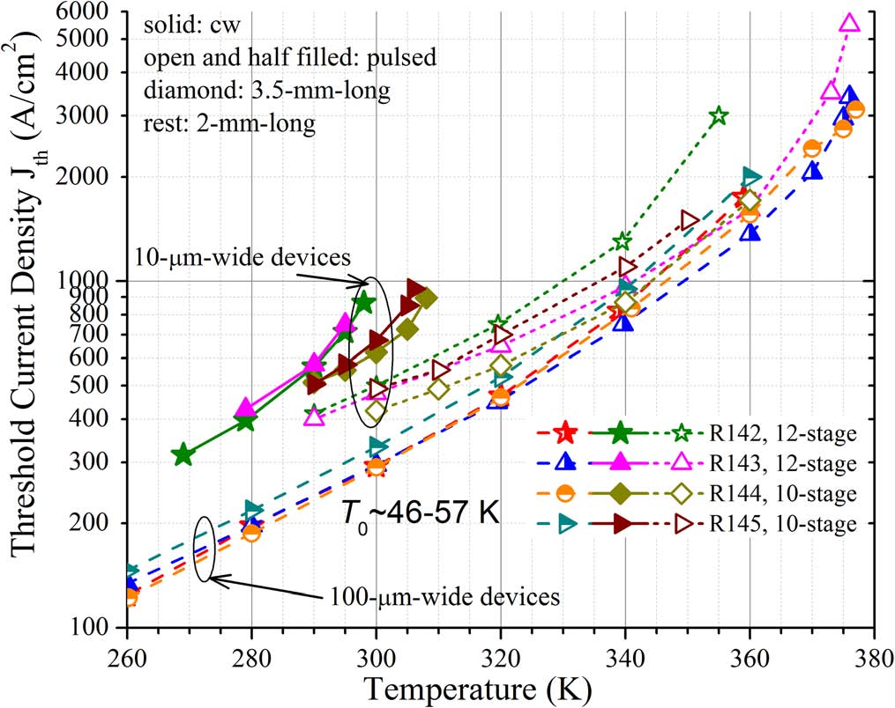
CW RT operation at λ=4.6-4.8 μm (2)
lowest J_{th} among diode lasers at similar wavelength
vs. R125 (lasers w/t hybrid wg):
up to 40% improvement
existing issues & future improvements:
NR device’s J_{th} ~50% larger than BA.
Better passivation to reduce leakage.
R_{sth}=6.5~11 Kcm²/kW, larger than 5.4 Kcm²/kW in GaSb-based IC laser.
Need to improve thermal dissipation.

Slide 21
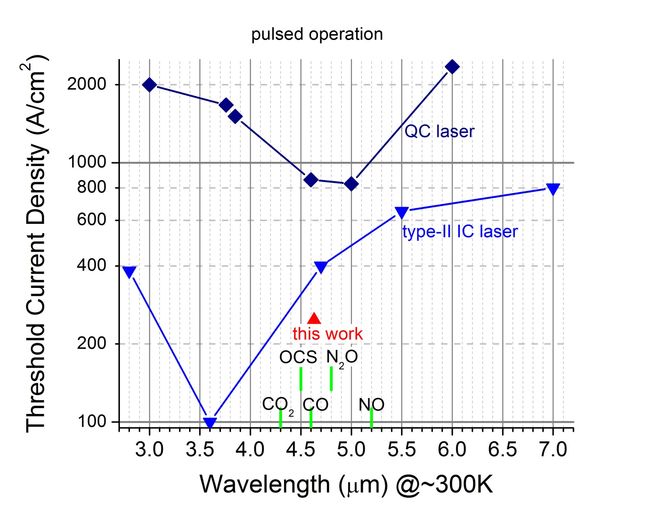
This work compare with others

Slide 22
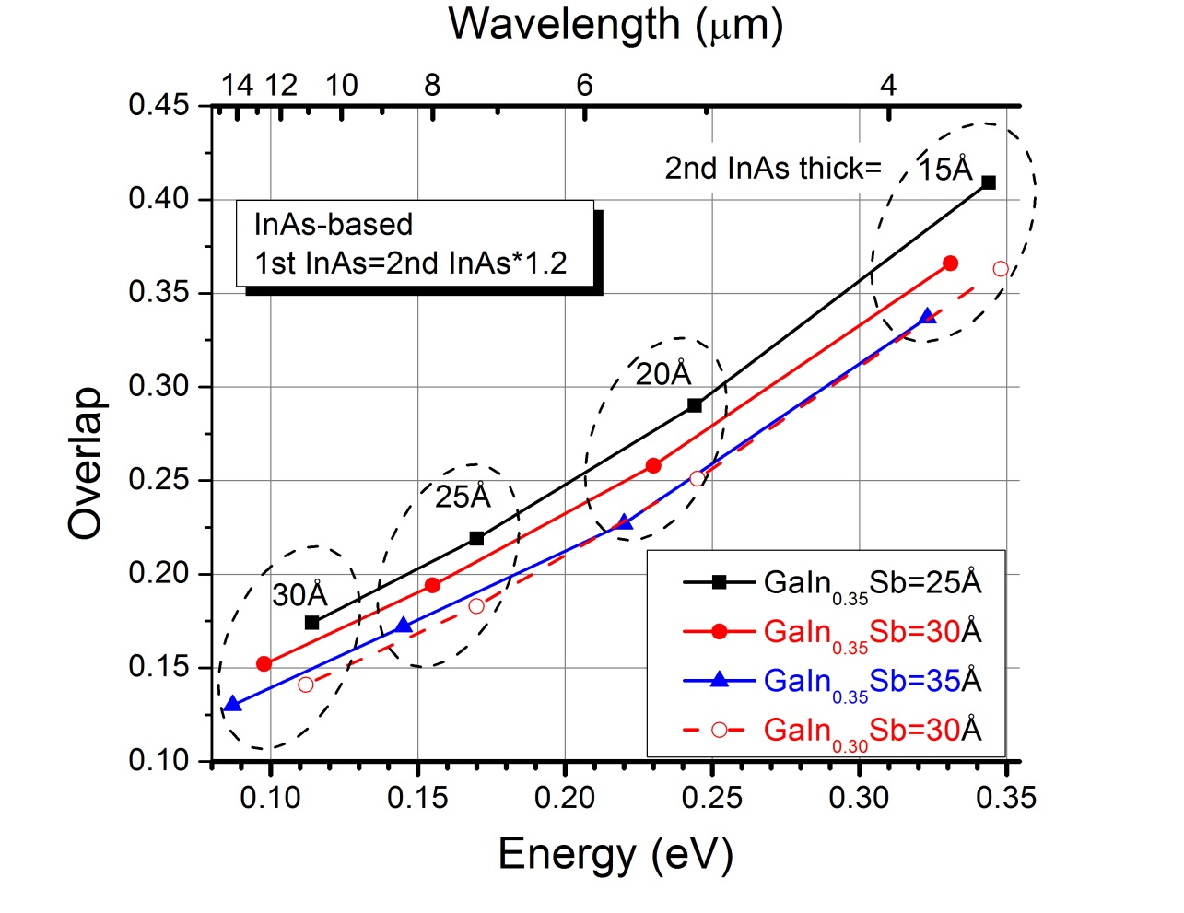
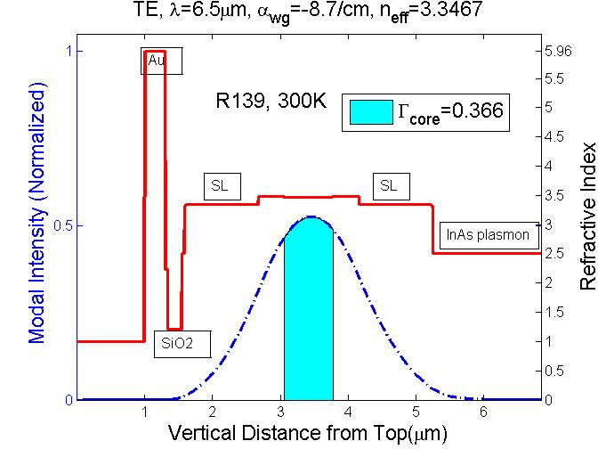
IC laser designed at λ=6.2-6.7 μm
Challenges | Solution
Reduced wavefunction overlap | new hole QW material ?
Reduced optical confinement | increase number of stages
Increased optical loss | hybrid waveguide, optimize doping

Slide 23
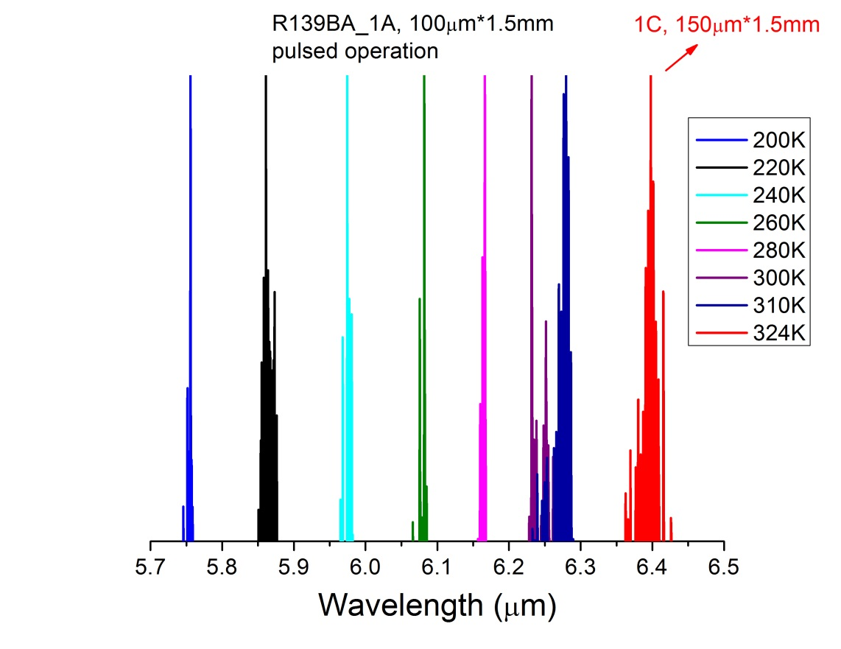
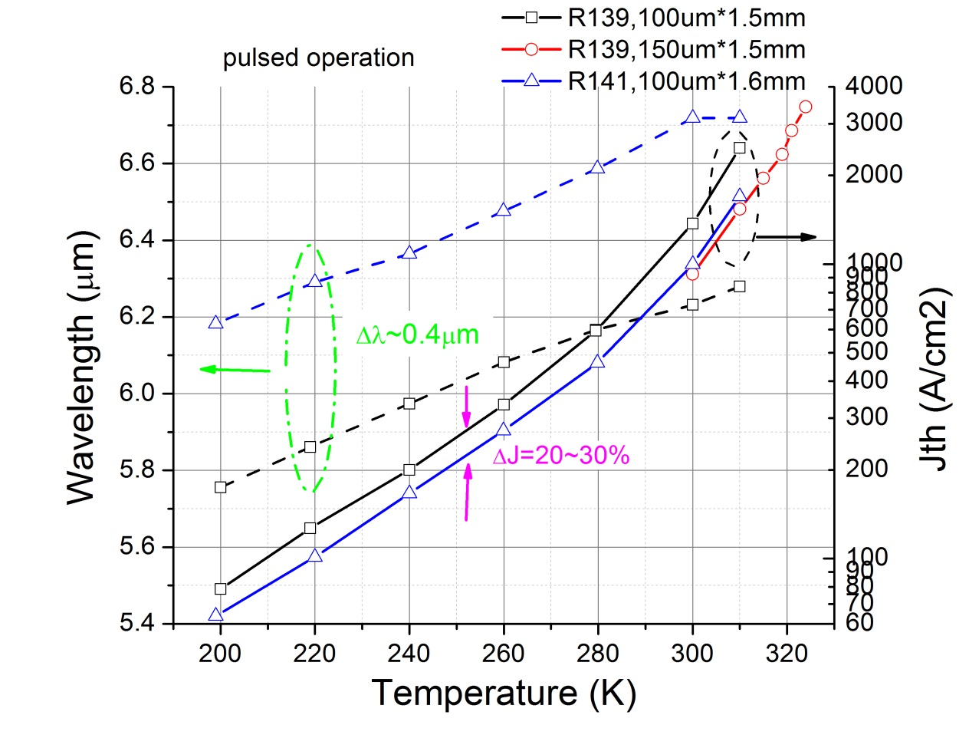
Pulsed RT operation at λ=6.2-6.7 μm
Results comparable to best IC lasers by a competing group
 | this work | SPIE,9550,0F(2015)
Pulsed J_{th} at 300K | 810 A/cm² (18 stages) | ~700 A/cm² (22 stages)
T₀ | 40 K | 41 K

Slide 24
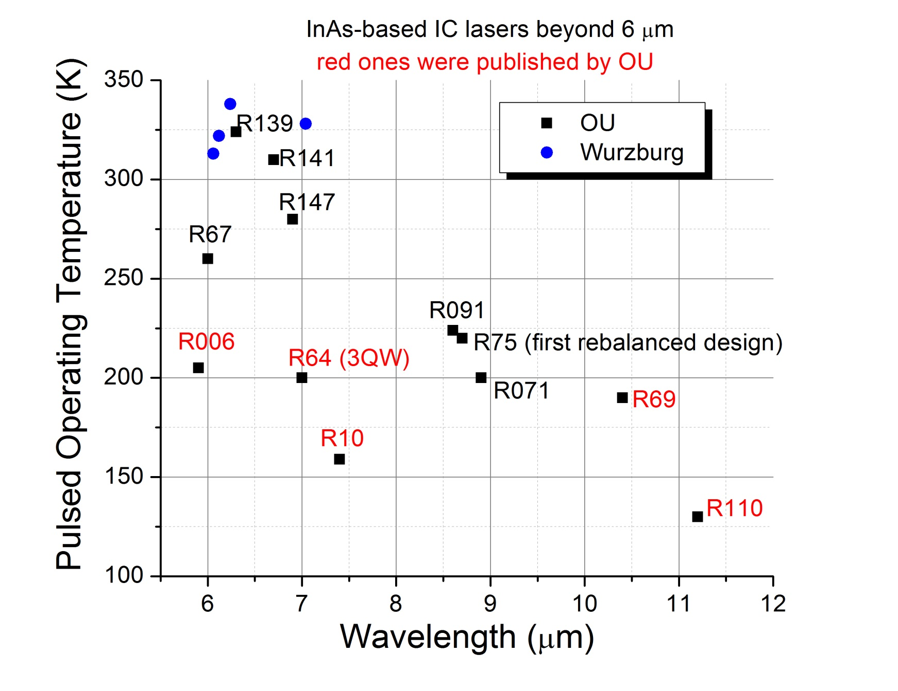
2015 status of IC laser at λ> 6μm
CW RT to be achieved soon!
CW RT achieved in 2017!
Pulsed up to 357K
Jth (300K) = 333 A/cm2
Collaborated with NRC
Rassel, et al. Opt. Eng(2018)

Slide 25
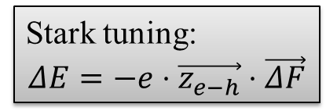
Electrically wide-tunable IC lasers
Why we need wide tuning:
spectroscopy
biochemical analysis
Tuning mechanisms:
Temperature tuning, based on Eg(T) or n(T)
cons: Slow
Grating tuning, such as external-cavity lasers
cons: Cumbersome, lack of long-term stability
Electric field tuning, based on the Stark effect
pros: responsive, convenient
challenge: electric field is difficult to change
after laser reaches threshold
solution: manipulate active region
Stark tuning:
$$ΔE=−e⋅\vec{z_{e−h}}⋅\vec{ΔF}$$
?

Slide 26
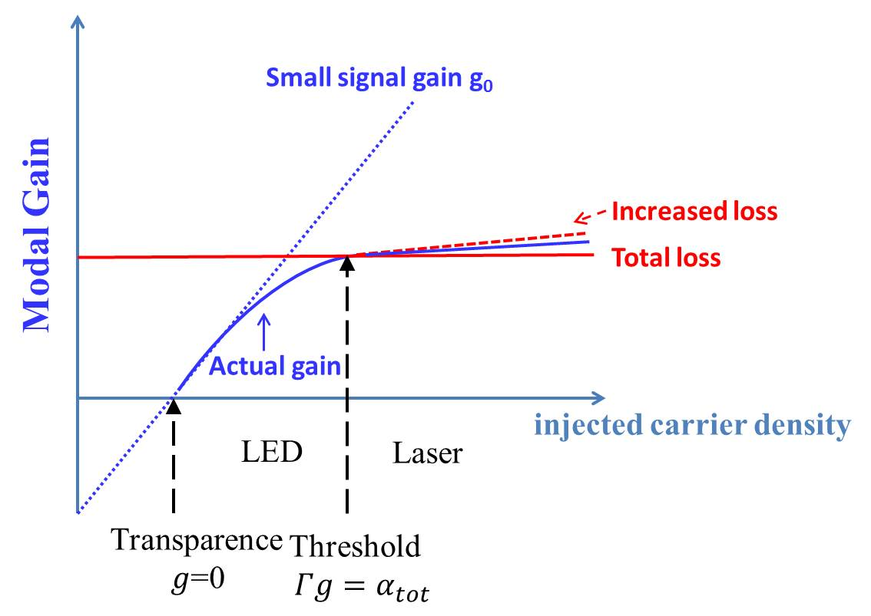
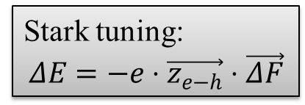
Electrically wide-tunable IC lasers
Stark tuning:
$$ΔE=−e⋅\vec{z_{e−h}}⋅\vec{ΔF}$$
how to change N?
Solution 1:
Create different J_{th} by
multiple sections
Solution 2:
Shift gain-loss balance by
reducing Γ
increasing α

Slide 27
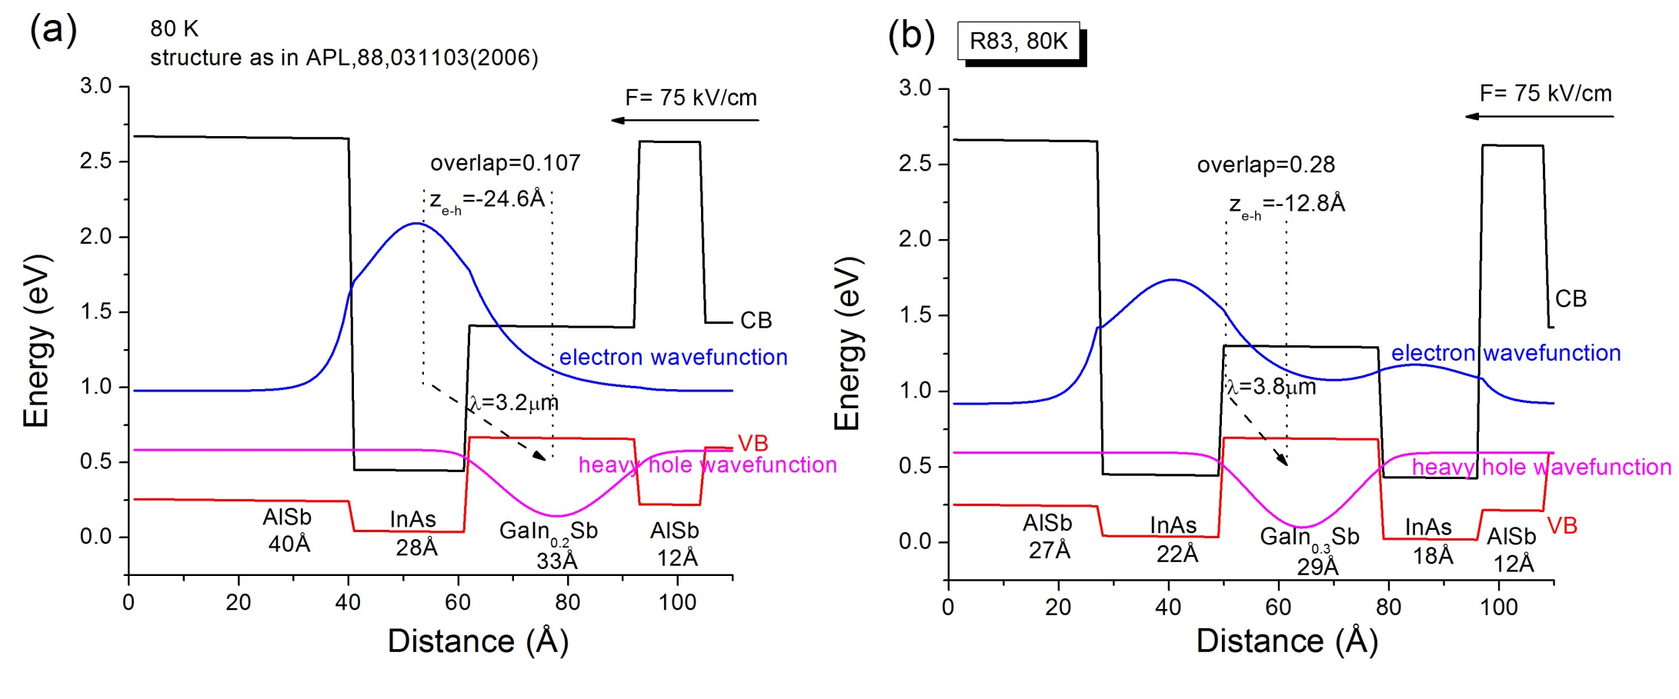
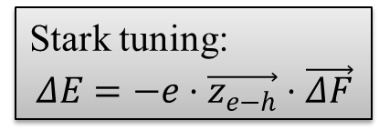
Electrically wide-tunable IC lasers
Stark tuning:
$$ΔE=−e⋅\vec{z_{e−h}}⋅\vec{ΔF}$$
Single QW
Double QWs
Z_{e-h} opposite to electric field direction -> blue-shift Stark tuning

Slide 28
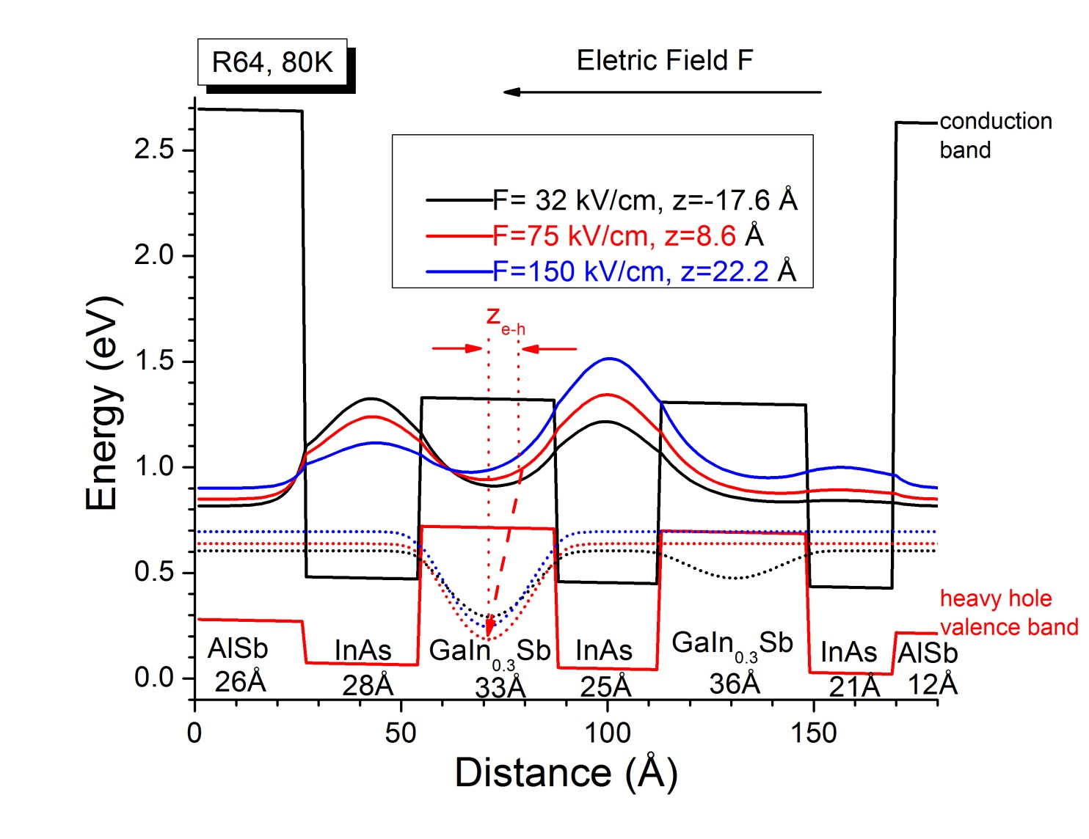

Electrically wide-tunable IC lasers
Triple QWs
Stark tuning:
$$ΔE=−e⋅\vec{z_{e−h}}⋅\vec{ΔF}$$
Z_{e-h} in the same direction with electric field -> red-shift Stark tuning

Slide 29
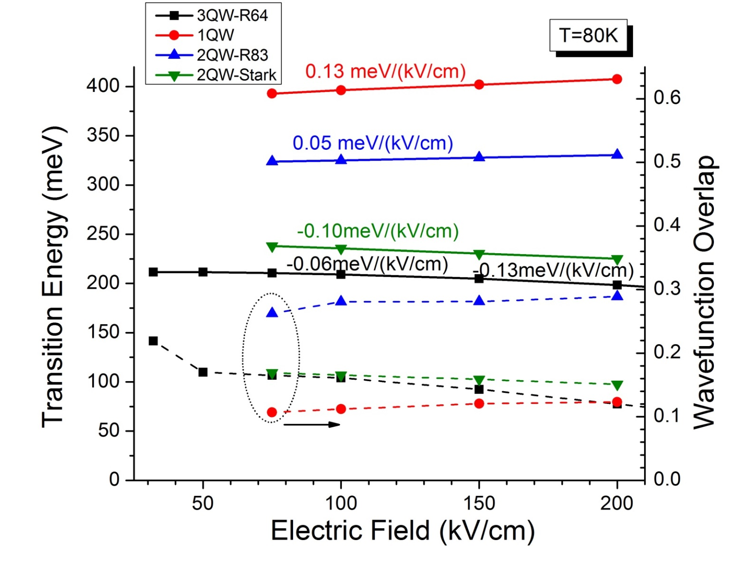
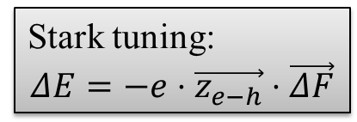
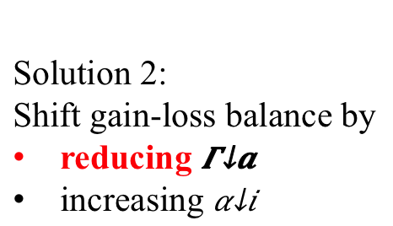
Electrically wide-tunable IC lasers
Stark tuning:
$$ΔE=−e⋅\vec{z_{e−h}}⋅\vec{ΔF}$$
Solution 2:
Shift gain-loss balance by
reducing $Γ_{a}$
increasing $α_{i}$

Slide 30
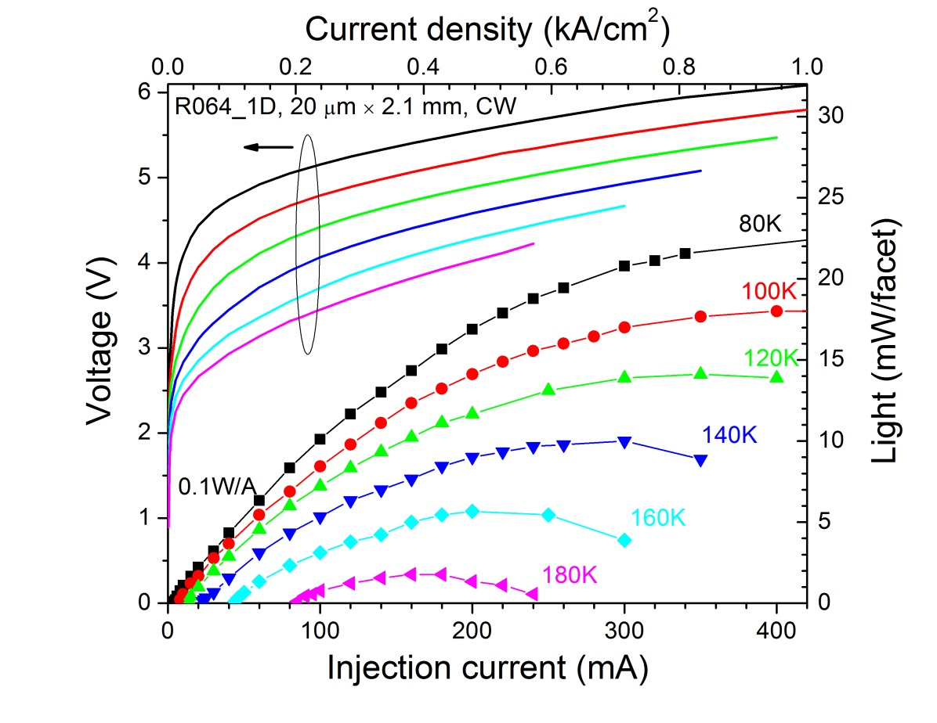
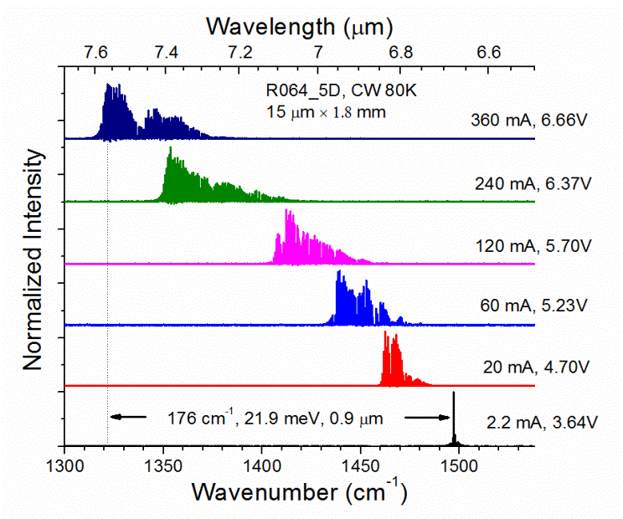
Electrically wide-tunable IC lasers
red-shifted by ~180 cm⁻¹ (22 meV or 900 nm) around λ=7 μm
∆U= 3V, a strong evidence of carrier unpinning
small power efficiency, indicates small differential modal gain and high loss
Y. Jiang, et al., J. Appl. Phys., 115,113101(2014)
I also co-author in a patent of this design, approved in 2016

Slide 31
GaSb-based type-I IC lasers at λ=3.2μm
J_{th}= 300 A/cm² at pulsed 300K
6-stage cascade core, SL waveguide
material grown by NRC of Canada
carrier transition in type-I QW
carrier recycling in type-II QWs
Y. Jiang, et al., Appl. Phys. Lett., 106, 041117(2015)

Slide 32
A detour after graduation
Why I paused MIR laser research:
insufficient funding even before my graduation
lack of security clearance for US IR laser industry
NIR laser is more marketable than MIR. e.g. Hesai Photonics Technology (禾赛):Laser-Based Remote Methane Leak Detector
What I did in Weathernews:
process geostationary satellite data using Python, C++ and Fortran
built machine learning model using meteorological data (GFS, WRF, METAR), improving the productivity of aviation forecaster. (~ 20 forecasters cover ~360 Asian airports 7*24 hours)
things learned: do we frame the question correctly and accurately?
this detour is like a sabbatical leave, or a dropout scheme in the deep learning model, giving me fresh mind back to laser research
Notes:
http://www.hesaitech.com/en/faq/laser.html?backUrl=/drone-mounted_natural_gas_surveillance_system.html
Capstone project: https://www.youtube.com/watch?v=w15GpupQusM

Slide 33
My expertise
Design of laser active core and waveguide:
focus on fundamentals → quickly pick up other types of lasers
write Matlab codes from scratch: https://github.com/jychstar/interband_cascade_laser
Build testing setup and benchmark:
suggest a rotation stage for far-field measurement
suggest fabrication size & testing condition for cross comparison
wrote Labview codes to get more precise data
used lock-in amplifier to detect very small ASE signal
Design experiments to explain anomaly phenomena:
temperature dependent P-I measurement for 11 um laser
EL & Hakki-Paoli measurement for gain spectrum of 14 um laser

Slide 34
What I can do for Hisense Photonics
Improve laser design by numerical simulation
Improve laser fabrication/packaging by empirical approach: trial-and-error, cost-efficiency analysis
Fully characterize laser and failure analysis at all stages
Automate data collection and processing
What I expect to learn in this position:
What are customers’ specific needs?
What are the industrial standard for a laser product?
How to transit from research phase to mass production?
What are potential research projects that can satisfy future’s application requirements

Slide 35
Back up

Slide 36
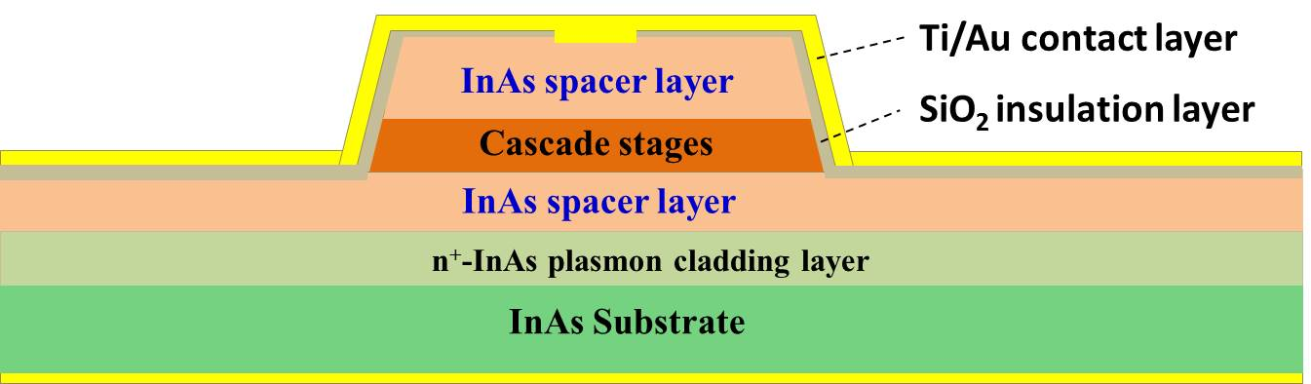
Waveguide variations
plasmon
frequency
doping
concentration
Drude model
tunable refractive index
-> flexible waveguide design
symmetric cladding
Contact
asymmetric cladding
further simplify growth
easier to fabricate top DFB grating
Plasmon cladding
InAs Spacer
Cascade Stages
n=3.45
InAs Spacer
n=3.49
InAs Plasmon cladding n~3
InAs Substrate

Slide 37
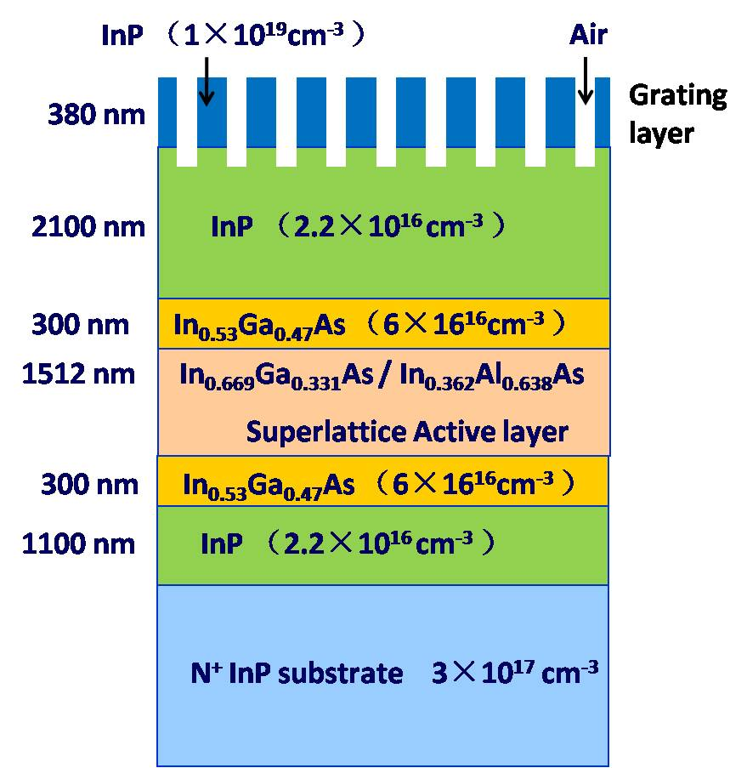
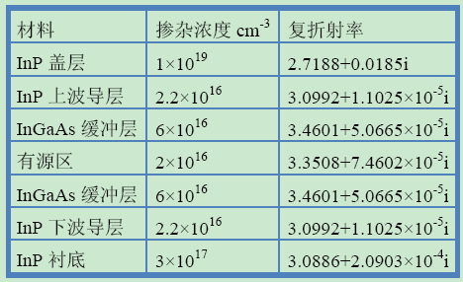
基于耦合波模型的理论计算
基本结构和参数
激射波长：~ 4.7 µm
有效折射率：~3.16
周期：~1.48 µm
深度：~0.5 µm
占空比：？
室温设计
SE-DFB-QCL结构示意图
各层掺杂浓度及折射率

Slide 38
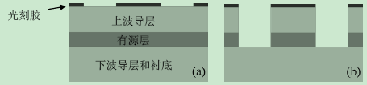

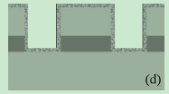
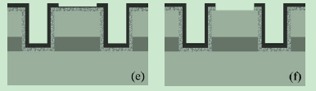
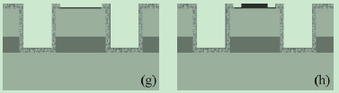
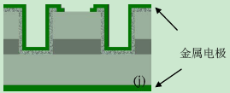
波长4.6 µm SE-DFB-QCL的制备
器件后工艺
SiO₂

Slide 39
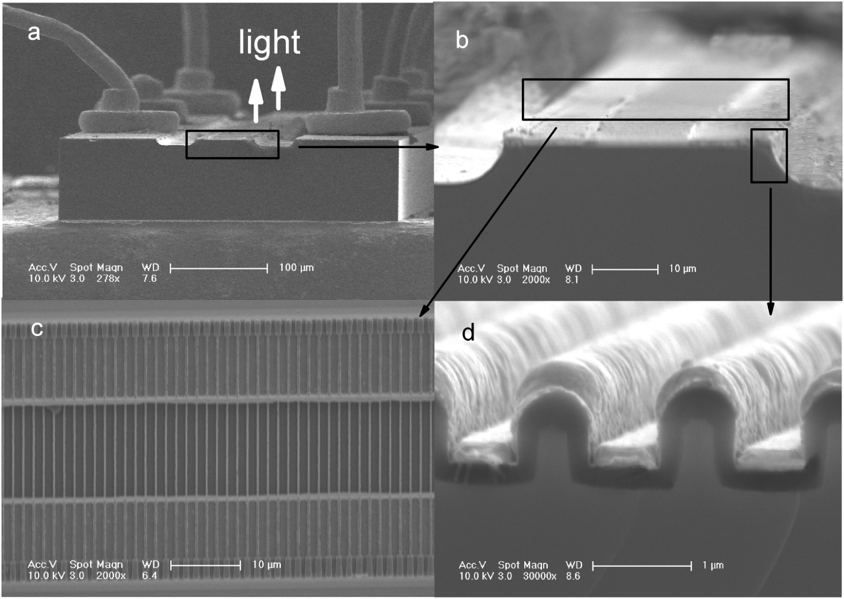
波长4.6 µm SE-DFB-QCL的制备
器件最终形貌
实际尺寸
周期：~1.48 µm
深度：~0.7 µm
占空比：25%

Slide 40
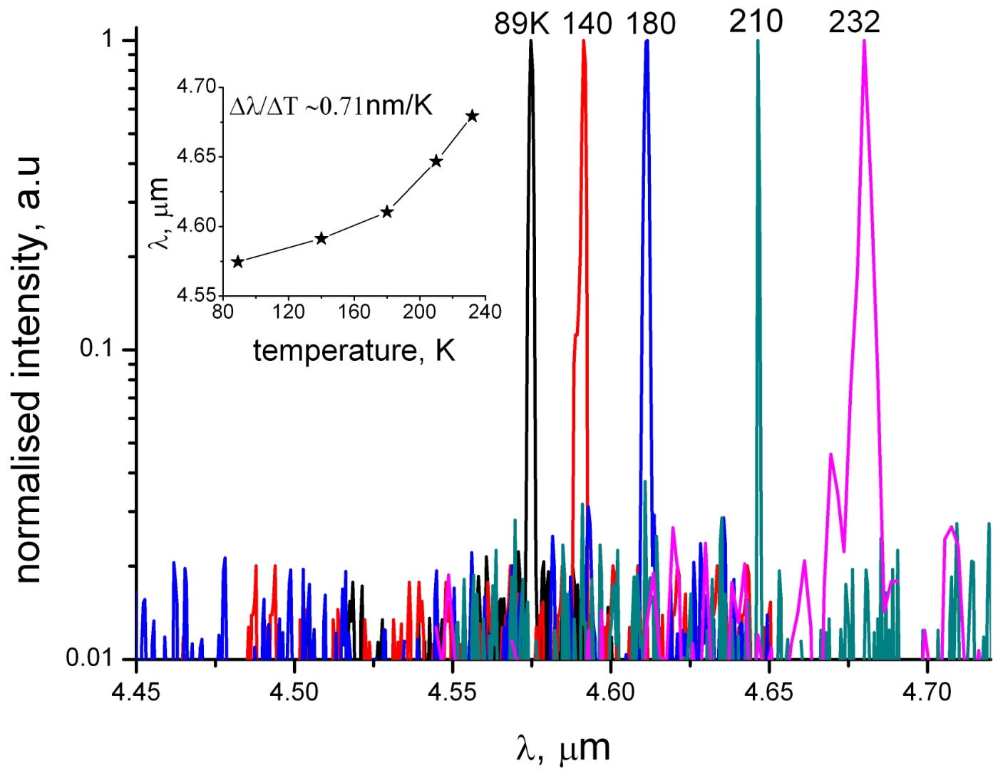
波长4.6 µm SE-DFB-QCL的表征
光谱
单模，SMSR>15 dB，中心波长4.5748~4.6795 μm

